Slide 1

What is most effective method to get Google search results into a RIS file format?
Gemma Madigan Johnson
Natalie King
Judy Wright
Information Specialists
Leeds Institute of Health Science, University of Leeds
Notes:
We have been doing research into what the most effective methods are for getting google search results into a ris file format

Slide 2

Why did we do this?
Google web searches are valuable sources of grey literature - 9% of included studies in a recent review came from Google searches.
Creating RIS/other files from Google web searches is problematic, time-consuming & labour-intensive.
Our team paste Google search results into a Word doc for the researcher to screen and flag relevant records, which we add to Endnote manually.
Is there a simple, accurate & efficient method?
Notes:
Google web searches are valuable sources of grey literature and can enhance searching methods for systematic reviews and other evidence syntheses. Based on a database analysis of a recent SR of ours found that about 9% of the final included studies came from google searches, so google searches stand to contribute greatly to reviews.
However getting google results into a reference management software is problematic & time-consuming, especially if there are a lot of records, and there is no consensus on best practice, some Information Specialists (IS) manually create records in ref software or avoid Google searches.
Our team paste Google search results into a Word doc for the researcher to screen and flag relevant records, which we add to Endnote manually. Alternative methods could be giving the researcher a search string and asking them to conduct and screen the searches themselves, and I’m sure some people do it differently still. Both these methods can prove difficult in deduplicating the results against the main body of the library.

Slide 3
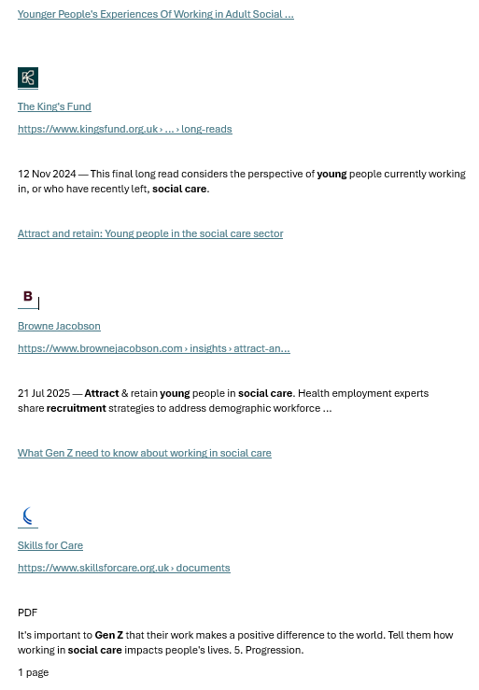
Methods: Google search string
young|Millennials|younger|"Gen Z" attract|recruit|recruitment "social care"|"care work"|"care homes"|"nursing homes"|Domiciliary
The Challenge
Make Google records easy to screen and deduplicate
Notes:
We started with a pilot study looking at 50 records.
We used the following search string focussing on social care from a recent review, and on the left you can see an example of the Word document we create with the results copied and pasted in. This contains a title linked to the document, name of the author/organisation, plus a brief abstract (snippet) of the page contents. This is what we used as our basis.

Slide 4
Pilot Study: Approaches
TY - WEB
AU -
PY -
DA -
TI -
T2 -
SP -
EP -
UR -
VL -
ER -
Manual
Create 50 blank RIS templates in notepad
Paste key info into RIS template
Mendeley
ChatGPT
Develop prompt to create RIS file
Copy URLs in batches
Word Macro
Analyse records to design Macro
Run Macro, process final edits in Word
Data-Miner
Find recipe, set parameters and run search
Process csv file for import into Endnote
Record Macro keystrokes in Word
Check accuracy
Click URL
Click Mendeley import widget
Add missing data to record
Export collection as RIS
Paste into notepad
Notes:
To give an overview of the approaches we used in the pilot study, we chose these approaches as we had a varying level of experience with them across our team.
First was manually populating a RIS template in notepad, then using a Mendeley click web extension to create citations from webpages.
We also tried using ChatGPT, creating a word macro and using a web-scraping tool called dataminer.

Slide 5
Pilot Study: Timings and Gold Standard
Capture time (running Google search and copy/pasting)
Creation/set-up (install/set-up software, RIS templates, Macro rules)
Run time (process results into a RIS file)
Total time (average time for all steps)
Total of 39 Gold Standard records were used which were captured by both IS. This number varied across approaches as some did not retrieve all 39, so analysis was restricted to what was present.
Mendeley = 39, ChatGPT = 35, Data-miner = 27, and Macros = 25.
Accuracy: Both TI-URL matches Gold Standard
Completeness: Both TI-URL were present
Partially missing: Title and/or URL partially missing by at least one searcher
Missing: Title and/or URL fields missed by at least one searcher
Major fields
Title
URL
Minor fields
Author, Tertiary author, Year, Date last updated, Abstract/Summary, DOI/ISBN, Source/Journal/Publisher
Notes:
We identified the main fields to be the title and the URL as these are the most necessary for screening, and the additional fields are desirable but not essential for screening decisions
We created the GS records for the pilot study by using overlapping results from two separate IS Google searches. Although we took steps to make these searches the same (done on same day, in incognito etc), there were only 39 records which overlapped which became the GS. The analysis for each approach was only limited to the number of GS records retrieved so the numbers for comparison did differ here – macros mushed records together for example and the data-miner search was done on a different day.
we measured how long each step took us and also measured the accuracy & completeness of each record, as well as if any records had missing or partially missing data

Slide 6
Pilot Study Results: Overall
 | Time to process 50 records | Completeness | Accuracy range | Average accuracy | Ease of use | Knowledge required
Manual | 1 hr 58 mins | 100% | 100% | 100% | EASY | LOW
Mendeley | 1 hr 27 mins | 97% | 89% - 100% | 92% | EASY | LOW
ChatGPT | 21 mins | 100% | 31% - 88% | 61% | MIXED | MEDIUM
Data-Miner | 33 mins | 100% | 100% | 100% | MIXED | MEDIUM
Macros | 2 hrs 59 | 96% | 4% - 96% | 52% | DEMANDING | HIGH
Key | 90-100% | 75-89%​ | 0-74% ​
Notes:
The results of the pilot study showed us that using Chat-GPT and Data-Miner were the fastest methods for producing RIS files, and both were 100% complete. We had a lot of variation with Chat-GPT accuracy but this is because our IS did different things, despite agreeing on a process beforehand.
Data-Miner was 100% accurate in the TI-URL fields. Worth noting this accuracy is for the main fields only. We did look at the add.fields and an interesting, but not surprising result, is that ChatGPT was 0% accurate as it generated all abs, despite instructions not to
From these results we wanted to do a scale up study on a larger sample size, focussing on Data-Miner and Chat-GPT.

Slide 7
Pilot Study Results: Summary
Title and URL capture
  Most complete ChatGPT, Data-Miner and manual
  Most accurate Manual and Data-Miner
  Fastest ChatGPT at 21 minutes
  Slowest Macros at 2hr 59 minutes.
Additional fields (including abstract/summary)
  Most complete ChatGPT, Mendeley and Manual (79%), followed by Macros (56%) and Data- Miner (51%).
  Most accurate Data-Miner and Manual (100%), followed by Macros (92%), Mendeley (86%), and Chat-GPT* (0%).
  *Chat-GPT generated 100% of its abstracts so assessing the accuracy was not practical
We decided to investigate using Chat-GPT and Data-Miner in more depth, as the other approaches seemed impractical.

Slide 8
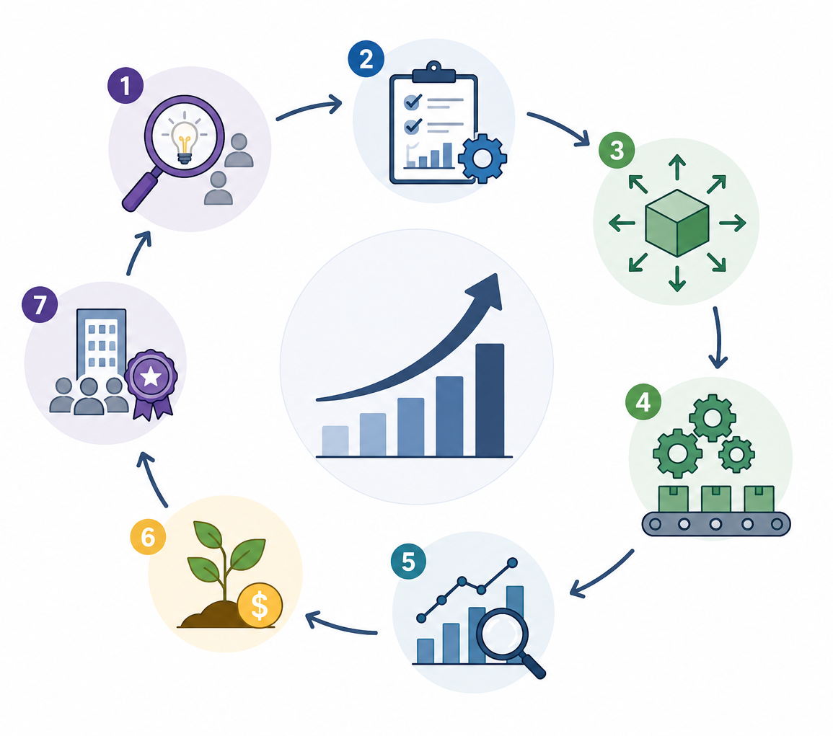
Scale-up Study: Methods
Same search string as the pilot study
Captured a larger sample (200 records)
Focussed on Data-Miner and Chat-GPT (two techniques)
Refined Data-Miner recipe and Chat-GPT prompts
Data-Miner records scraped at the same time as Google search
Each method tested by two Information Specialists
Endnote deduplication function used to match records

Slide 9
Scale-up Study: Approaches
Chat-GPT #1
URL only
Chat-GPT #2
Text from Word
Create Word doc of Google search results
Copy/paste text in batches
Data-Miner
Edit generic Google recipe to capture more complete records
Process CSV file for import into Endnote as tab-delimited file
Copy/paste text from Word doc & check accuracy
Create Word doc of Google search results
Copy/paste RIS records into notepad
Copy/paste RIS records into notepad
Open URLs from Word doc in web browser
Copy URLs in small batch & check accuracy
Copy/paste URLs into ChatGPT in batches
Run Google search & scrape first 20 pages
Export file in CSV format
Develop prompt to create RIS records from extracted URLs
Develop prompt to create RIS records from copied sections of Word doc
Notes:
To give more details on the approaches we took in the scale up study, both the chatgpt approaches used a very similar prompt, with few words changed to give more context. The main difference is that method 1, URL only, involved opening the URLs from the Word document and copying them directly into chatgpt, whereas the second method, text from word, involved copying the text from the word document into chatgpt, including the google snippet. Both chat-gpt methods used version 5.5.

Slide 10
You are assisting with data extraction for a systematic review. I will provide a list of URLs. For each URL, follow these instructions carefully.
Identify and extract all relevant hyperlinks (URLs) from the provided Google search results.
For each extracted URL, visit the page and extract the following information:
Title of the page
URL
Author (if explicitly named)
If no author is named, extract the organisation responsible for the content
Publication date (only if explicitly stated)
Abstract or summary (only if there is a clearly labelled "abstract" or "summary" section)
Important rules:
Do not infer or guess missing information.
If no author is named, use the organisation as the author.
If no date is provided, leave the date field blank (do not assume the current year).
If there is no explicitly labelled "abstract" or "summary", leave the abstract field blank.
Do not generate or paraphrase summaries.
Extract only what is explicitly present on the page.
Format each record in RIS format using the following structure:
TY - WEB
TI - [Title]
AU - [Author or Organisation]
PY - [Year or full date if available]
UR - [URL]
AB - [Abstract/Summary if present]
ER -
Output:
Provide all records in a single, continuous RIS-formatted block.
Ensure the output is clean and directly copyable.
Do not include explanations, commentary, or extra text—only the RIS records.
I will now provide the Google search results. Please provide it in a copyable format.
Notes:
This is an example of the prompt used for Chat-GPT, which we actually got Chat-GPT to write itself. We had lots of issues with the pilot prompt regarding hallucinating abstracts, so we wanted to ensure the instructions were clear and thought chatgpt would know the best way to tell itself to do that.

Slide 11
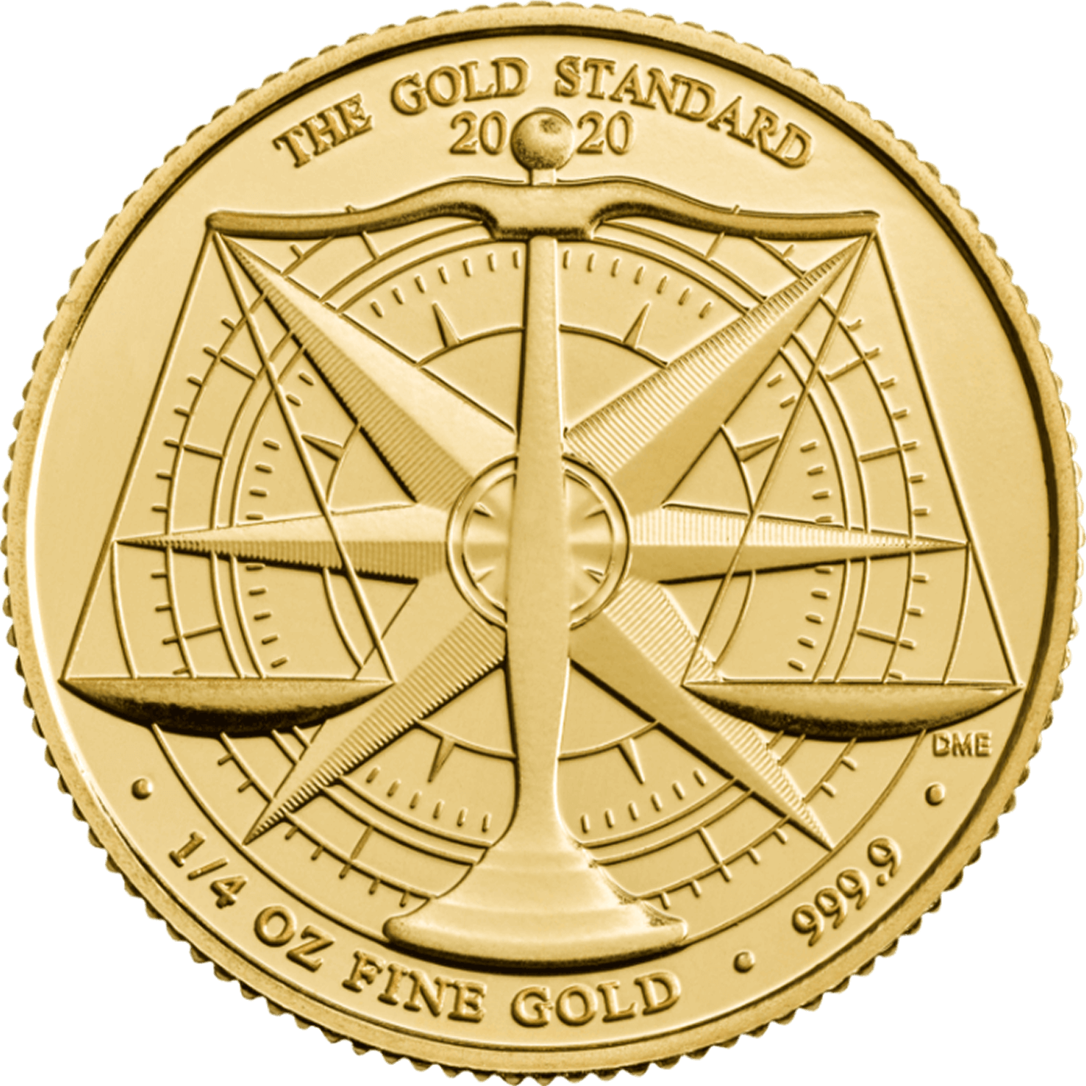
Methods: Gold standard records
First 20 pages of Google results copied and pasted into Word document to capture 200 records
One page displayed 9 results instead of 10, resulting in 199 captured records
Used Mendeley to generate records for each result
If no abstract or summary was obvious, we used the Google snippet captured on the Word doc
Records with broken links were removed from the total for analysis
The final number of Gold Standard records was 194
Notes:
To create the GS records we edited our process a little from the pilot study:
2 IS ran the same Google search at the same time in incognito, but we only used one set of results as our GS rather than combining for overlap as this reduces the number due to natural variation in searches. We aimed to capture 200 records so scraped the first 20 pages
Ended up capturing 199 records due to one page… We copied and pasted into our Word doc as usual
We then split the document into 3 and each IS used Mendeley click web extension to create a GS record – got extra info and used Google snippet if no abstract
Due to some time passing between capturing the results and creating the GS/analysis we had 5 records with broken links that were removed from the final total – 194 GS records

Slide 12
Methods: Timings & parameters
Accuracy: Both Title and URL fields match the Gold Standard
(includes titles which differ but convey the same meaning, and different URLs linking to the same page)
Non-duplicates: Records not matching the Gold Standard and comparator set
Similar Title-Different URL: Same/similar title but wrong URL (including broken links)
Additional fields: Records with some or all the desired additional fields
Completeness: Records with both Title and URL fields completed, or additional fields completed
Time taken: To capture and process Google search results
Major fields | Additional fields
Title | Abstract/ Summary
URL | Author
 | Year
 | Journal/ Organisational author
Notes:
Main fields are the title and the URL – these are the most important fields to be present and accurate for deduplication and screening
The add. Fields are desirable sure, particularly the abstract and maybe the author, but are not strictly essential for making a screening decision

Slide 13
Results: Time for ~200 records (mins:secs)
Method | Prep time | Scrape time | ChatGPT processing time | Total Time | Time minus prep-time | Scale-up time
ChatGPT #1 URL only | 06:39 | n/a | 47:38 | 51:17 | 47:38 | 02:23
ChatGPT #2 Text from Word doc | 05:39 | n/a | 30:00 | 35:39 | 30:00 | 1:30
Data-Miner | 12:56 | 04:37 | n/a | 17:33 | 04:37 | 00:14
Despite a longer prep time, Data-Miner captured records faster than both Chat-GPT versions.
Notes:
These timings are averaged out between our 2 IS. Data-miner had the longest prep time but was the fastest method overall and only took 17.5 mins to scrape about 200 records. It also presents the fastest scale up time, about 14 seconds per page of google (10 results)
There was little difference between the two ChatGPT methods – method 1 taking 50 mins and method 2 taking 35 mins.

Slide 14
Results: Accuracy
What is ‘good enough’ for screening decisions
‘Close enough’ duplicates:
Correct URL - wrong title: ChatGPT creating titles, potentially making misleading ones?
Correct title but wrong / broken URL:
Notes:
Want to give some egs of what our records actually looked like – worth mentioning here that our ‘close enough’ did end up being quite subjective due to natural diffs between IS
If the automated version was assumed correct rather than gold standard you would miss search results - unique records in both gold standard and automated versions

Slide 15
Results: Accuracy of Data-Miner / ChatGPT (compared with gold standard)
 | TI-URL match (or close-enough match for screening) | Correct URL wrong Title | Correct Title wrong/broken URL in comparator record | Unique records – match not found | All fields match (TI, URL, AU, YR, JO, AB)
ChatGPT #1 URL only | 81% | 15% | 1 | 9 | 0%
ChatGPT #2 Text from Word doc | 22% | 3% | 138 | 18 | 0%
Data-Miner | 90% | 6% | 2 | 12 | 0%
Data-Miner records most closely matched the gold standard, but some records still captured incorrect details
Notes:
Data-Miner produced the most accurate records but did still give some inaccuracies, but not significantly more than chatgpt.
There was a lot of variation between the 2 chat-gpt methods in terms of accuracy. There was a small difference in the wording of the prompt which produced one set of records with almost entirely unusable URLS – 138/194 were broken.

Slide 16
Results: Additional fields
What is ‘good enough’ for screening decisions
Method | Author | Year | Abstract
Gold Standard | 100% | 46% | 100%
ChatGPT #1 URL only | 100% | 8% | 1.5%
ChatGPT #2 Text from Word doc | 100% | 20% | 100%
Data-Miner | 100% | 0% | 100%
All methods provided an author field.
Data-Miner and Chat-GPT #2 provided an ‘abstract’.
Chat-GPT #1 provided virtually no abstracts even though going directly to each Google result via the URL.
Less than half the Gold Standard records contained information on Year. No method reliably retrieved this field.
Notes:
It’s worth mentioning here that this is looking at the completeness of the records rather than accuracy – whether the field was completed but it has not been compared to the GS to check it is accurate.
-All methods provided an author
-Chat-GPT #2 and data-miner got all abstracts but chat-gpt didn’t – we assume this is due to it being told not to generate abstracts and it was not given the text with the google snippet in like version 2.
-year recall was low across the board, even in the GS
Abstracts:
ChatGPT 1 barely any abstracts, as we told it very strictly not to create any abstracts unless there was one obvious on the webpage, and the google snippet information was not given in this approach
-ChatGPT2 – we have not analysed the accuracy of these (whether they match the GS), but 100% abstracts were complete. However only 40 records (out of 194) match when using endnotes deupe function, which suggest that it is is still creating its own abstract (not from web page or snippet) and is not consistent between users
-DataMiner is providing the same snippet found browsing if google or the word doc of google search results – not comprehensive but ‘enough’
Year:
Fairly low across all approaches - might be the topic as less than half the Gold Std records contained a date. Chatgpt 2 did get the most, and this is likely bc the google snippet was input into the system and, even if no date is mentioned on the webpage, it is sometimes included in the google snippet.

Slide 17
Results: Overall
 | Process time 200 records | % Records TI-URL match (or close-enough) | Number of wrong (mis-matched URL) records | Unique records across GS and comparator | Additional fields completed | IS rated ease of use / liable to human error
Chat-GPT #1 URL only | 51:17 | 81% | 1 | 9 | All authors 1.5% abstracts 8% years | Error prone, intensive concentration for opening & copying all URLs
Chat-GPT #2 Text from Word doc | 35:39 | 22% | 138 | 18 | All authors All abstracts 20% years | Error-prone for copy batches of Google results
Data-Miner | 17:33 | 90% | 2 | 12 | All authors All abstracts 0% years | Simple once set up & familiar with interface.
Key | Good | Medium | Poor​
Notes:
Looking at the overall results:
Data-miner was the fastest & the most accurate, it retrieved all of the most useful add.fields and is very simple to set up and run, once you are familiar with the interface. It does produce a handful of unique records or wrong records, but comparing this to the results of our pilot study which was 100% accurate, it suggests that the more records you scrape the more error prone it can be. This depends then on practice, but we are prone to doing several smaller searches of 50 results rather than one large result set like this of 200 results, so if you are using it for small batches it has potential to be error free.
One chat-gpt method was faster but a lot more inaccurate, and the other was slower but more accurate. Both methods were very error-prone and required a lot of concentration and double checking.

Slide 18
Reproducibility
Similarity in TI-URL matches between Information Specialists
 | % Records with ‘good enough’ TI-URL match | Wrong records (mis-matched URL) from both IS sets | Non-duplicate records from both IS sets
ChatGPT #1 URL only | 88% | 2 | 9
ChatGPT #2 Text from Word doc | 14% | 257 | 86
Data-Miner | 65% | 8 | 128
Chat-GPT methods produced different results from two Information Specialists, despite using same prompts and same set of Google search results.
Data-Miner searches were not reproducible – as expected, due to differences in underlying Google search results for each IS.
Notes:
No method is fully reproducible 2 IS.
The main takeaway is that both Chat-GPT methods gave different results for each IS, despite using the same prompts, the same set of results and running it on the same day on the same version of Chat-GPT. Of these two methods however Chat-GPT 1 does have a higher level of reproducibility, likely as the information is coming directly from the URLs, rather than from the pasted links in a word document.
Data-Miner searches were not reproducible, which we did expect due to the nature of google searches. Again, we did these search esat the exact same time in incognito mode to try and migitage these differences, but when comparing the two set of results together there was only a 65% overlap and a lot more non-duplicates.
Google searches are not reproducible in themselves, but dataminer does give an accurate capture of an individual google search and can be reported relatively transparently.

Slide 19
Summary
No method is fully reproducible, but Data-Miner gives the most accurate records for large datasets, as well as being faster and giving more content
Chat-GPT was slower, error-prone and the results were less accurate
For medium to large sets of results, automated tools can save HOURS
For small sets of results needing highly accurate, complete content create manual records.
Other Gen-AI tools and web-scraper software may perform better (or worse).
Notes:
Having this information can help us better plan our time and help us incorporate these supplemental searching techniques into our usual processes with a lot less faff than manual creation

Slide 20
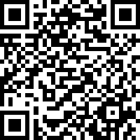
Future plans
Different topics to avoid job listings
Test targeted mini-Google search strategies of 50 results, rather than one large Google search for the research question
Other AI tools or web-scraping software.
Please give us your suggestions!
How do you manage Google results?

Slide 21
Thank you!

