Slide 1
Literature Searching Using MEDLINE
LIHS Mini Master Class
© Alexandru Nicusor Matei 2013 CC BY-NC-ND 2.0
Natalie King
Natalie King© University of Leeds 2015. This work is made available for reuse under the terms of the Creative Commons Attribution-NonCommercial-ShareAlike 4.0 International Licence.

Slide 2
Questions?
What is Medline and why use it?
What are all the ‘other’ Medlines?
Why not just enter my essay question/ research project title? Simple search strategy design.
What are the 2 types of searching?
What does AND, OR, NOT combinations actually do?

Slide 3
Pros and Cons of Medline
The largest database of Medical literature. 22 million records from ~5600 journals
High quality accurate records
Specialised subject indexing
But OTHER databases…
Include conferences, theses, reports, books, grey lit.
Cover some subjects in greater depth e.g. drugs (Embase), Psychiatry (PsycInfo), Nursing (CINAHL), European literature (Embase), Complementary Medicine (AMED)
Notes:
WHY USE MEDLINE
To systematically search across numerous journals simulataneously
Pubmed contains an additional 3 million records
* includes Medline and Medline in Process
*plus records out of scope (eg medline journal but non-ML content ie plate tectonics)
* Life sciences articles in PMC that arent indexed in ML
*old citations waiting to g ointo ML
*some books

Slide 4
Google vs Medline
Smoking
Google: 535 000 000
Medline: 154 312
Smoking AND acupuncture
Google: 2 000 000
Medline: 136
Smoking AND acupuncture AND cessation
Google: 419 000
Medline: 78
Notes:
Why use

Slide 5
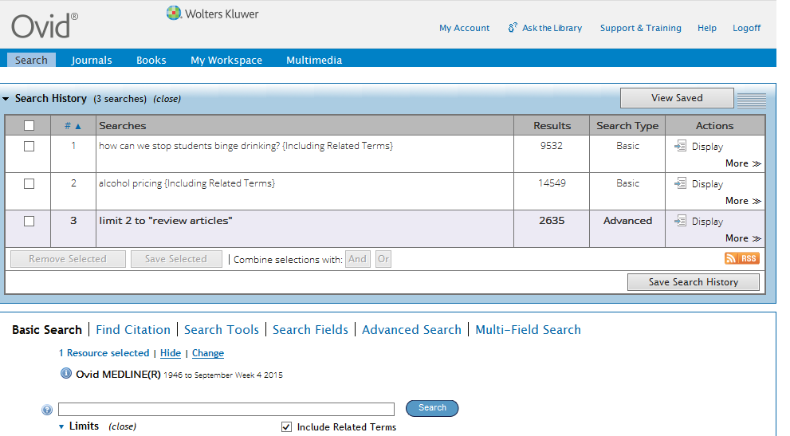
Basic Search – for quick simple questions
Notes:
Natural language search
Produces a lot of hits but ranks them for relevancy 5* all concepts to 1* (2+ missing)
Good for
*finding a few relev articles quickly
*getting an overview of the topic (particularly if it has multiple concepts or you are unfamiliar with the disease/drug name
Cannot combine searches

Slide 6
2 types of searching??
Text word search in Title and Abstract
Subject Heading Search
Notes:
Subject headings:

Slide 7
1. Text word searching

Slide 8
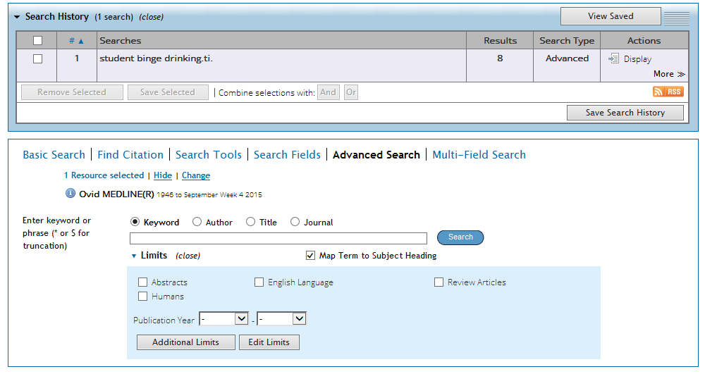
2. Subject Heading (MeSH) searching
Notes:
Every item indexed using a controlled vocabulary from a controlled list of words – Thesaurus
Why? Consistency – find articles when your search terms arent used (diff authors, different countries, different eras eg bedsores, decubitus ulcer, pressure ulcer/sore
Heart attack indexed as myocardial infarction

Slide 9
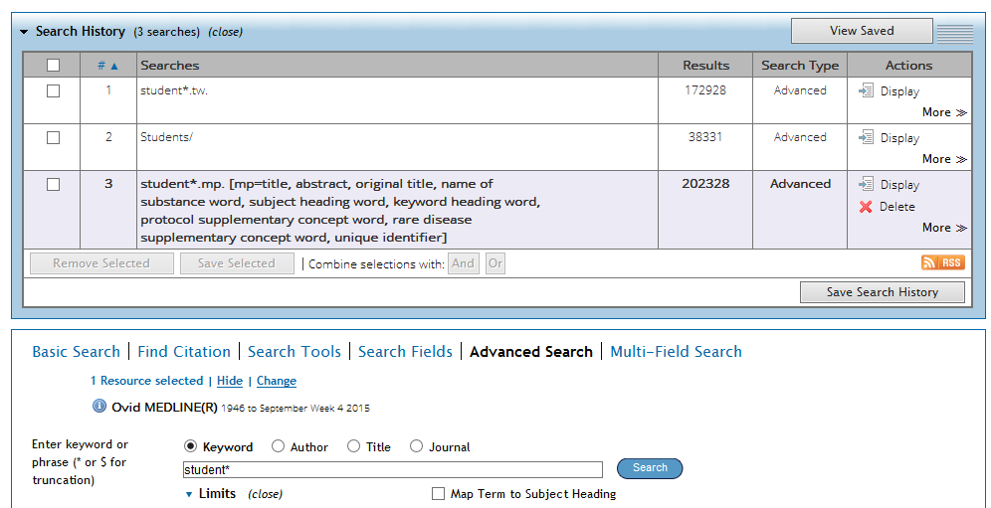
Keyword search
Includes text words and subject headings
Beware – can pick up wrong headings and lots of irrelevant results
Notes:
Keyword search .mp = multipurpose
Looks for word in ti, ab, subject headings – can pull up lots of irrelevant & unrelated terms

Slide 10
AND, OR Search Combinations
Search Strategy:
Students
Binge drinking
Reviews
1 AND 2 AND 3

Slide 11
Boolean operators
Binge drinking
Students
Students
Binge drinking
OR – to expand search
AND – to narrow search

Slide 12
Bringing it all together
AND
Students
OR
Recreational Drugs
NOTAND
Binge drinking
OR
Recreational Drugs
NOT
AND
We are only interested in
these articles

Slide 13
NOT
e.g. Binge drinking studies excluding those mentioning cocaine / street drugs.
Type set numbers with not in search box e.g. 9 not 12

Slide 14
Summary & Further Support
Variety of ways to access Medline data – focus on developing your skills in one
Advanced search allows you to use textwords and subject headings in simple (and complex) strategies
Further Support
Help button (top right corner)
OvidSP databases help (includes Medline) http://library.leeds.ac.uk/info/366/databases/73/database_guides/4 includes demos, online tutorials, workbooks
PubMed help http://library.leeds.ac.uk/info/366/databases/73/database_guides/5

