Slide 1
Grey Literature
is
30/01/2018
Rocio Rodriguez
Information Specialist AUHE

Slide 2
What is Grey Literature (GL)?
“Literature that is not formally published in sources such as books or journal articles” Cochrane Handbook

Slide 3
Examples of useful Grey literature for Health Sciences
Clinical trial Register Records
Health Technology Assessment reports
Regulatory Agency reports (EMEA, FDA,MHRA)
Guidelines
Government reports
Theses and Dissertations
Conference Proceedings
Drug company reports
Working Papers
Medical Society reports

Slide 4
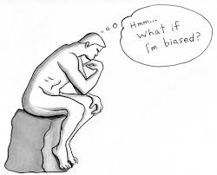
Why is Grey literature important?
1. Avoid Bias
2. Reports based on GL
3. Check new research

Slide 5
You could be right….
of trials have never reported results
All trials. Half of all clinical trials have never reported results http://www.alltrials.net/news/half-of-all-trials-unreported/

Slide 6
Characteristics of the grey literature (Sometimes)
Notes:
Hard to find
Free (Normally)
High quality information (Normally)
Peer review ? Sometimes
Updated information about specific subjects

Slide 7
Assessment of GL: AACODS
The AACODS Checklist, put together by Jess Tyndal at Flinders University https://dspace.flinders.edu.au/xmlui/bitstream/handle/2328/3326/AACODS_Checklist.pdf;jsessionid=0D9DFCCC81F5E8CFCFC2357DDD60EFF0?sequence=4
Notes:
Authorship. Although there are no named authors, the report describes groups of Key Informants and Technical Experts consulted for the report starting on page 13. How potential conflicts of interest are handled is discussed there as well.
Source of the Report. The source - AHRQ - is clearly stated on each page. This is a well-respected U.S. Government agency, in the .gov domain, which is listed in many collections of grey literature producing organizations.
Transparency of Methods. The methods and evaluation criteria are clearly outlined starting on page 6 of the report. The search strategy used to generate literature for review is provided in an appendix to the report.
Currency. The date, December 16, 2011, is clearly indicated on each page of the report.

Slide 8
Where to find grey literature for a SR of RCTs?
Clinical Trials Registers
CENTRAL
AUHE’s list of Clinical Trials and Research Study Websites and Registers https://medhealth.leeds.ac.uk/info/639/information_specialists/1790/finding_randomised_controlled_trials

Slide 9
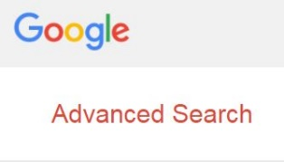
Where to find grey literature for a PH Report?
Grey Literature Sources
Official Sites and Statistics
Search Engines

Slide 10
Indexes of Grey Literature
Public Health England’s Index
http://phe.baileysolutions.co.uk/custompage6.aspx
Grey Matters https://www.cadth.ca/resources/finding-evidence/grey-matters
HTA on the Net https://www.ihe.ca/download/health_technology_assessment_on_the_net_2016.pdf

Slide 11
Briscoe, S. (2015) Web searching for systematic reviews: a case study of reporting standards in the UK Health Technology Assessment programme. BMC Res Notes, 8, pp. 153. https://bmcresnotes.biomedcentral.com/articles/10.1186/s13104-015-1079-y

