Slide 1
Grading the evidence
LIHS Mini Master Class
© Alexandru Nicusor Matei 2013
CC BY-NC-ND 2.0
Liz Mitchell
Liz Mitchell © University of Leeds 2015. This work is made available for reuse under the terms of the
Creative Commons Attribution-NonCommercial-ShareAlike 4.0 International Licence.

Slide 2
Why grade evidence?
“Of course we must be willing to change our minds when warranted by new evidence. But the evidence must be strong. Not all claims to knowledge have equal merit”.
~ Carl Sagan (astronomer and author)

Slide 3
Differentiate the “good” from the “bad” and the “ugly”.
No guarantee of validity by:
Peer-review
Journal reputation
Author credentials
Researcher experience

Slide 4
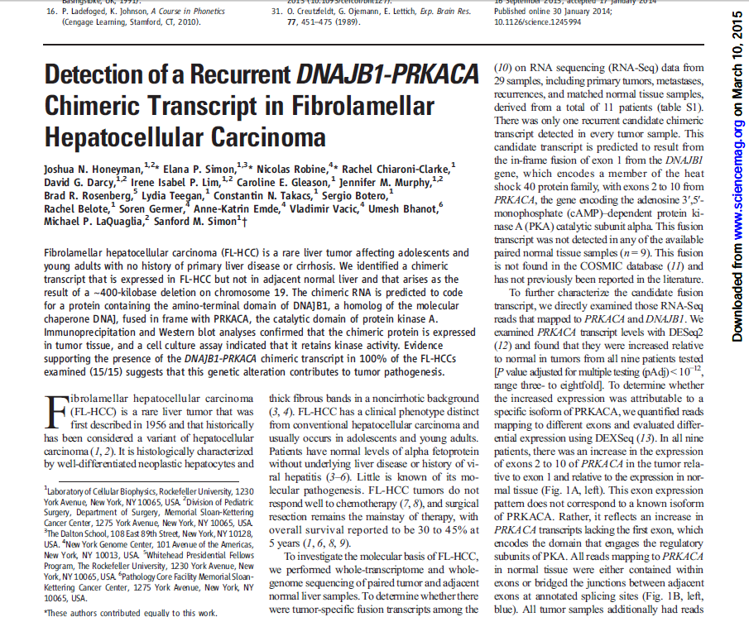
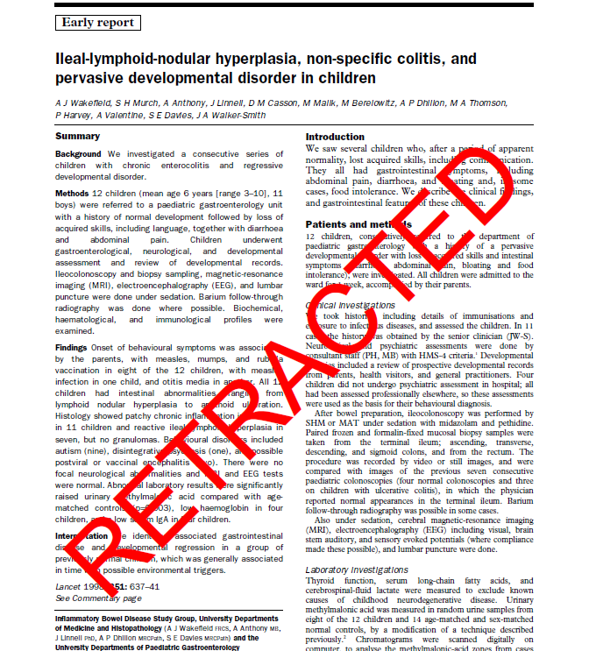

Slide 5
Differentiate the “good from the “bad” and the “ugly”.
No guarantee of validity by:
Peer-review
Journal reputation
Author credentials
Researcher experience
Requires assessment of methodological rigour.

Slide 6
Evidence hierarchy
SR
RCTs
Anecdote, opinion, experience
Case report, case series, descriptive
Cohort, case-control, before & after
Non-randomised controlled trials
Validity (number, comparator, allocation to intervention)
Bias

Slide 7
However…..
Rank on the hierarchy does not guarantee quality or validity.
Evaluating findings in isolation is not enough.
Invalid methods produce invalid data.
Full assessment requires review of:
Design
Methods
Results
Conclusion/context

Slide 8
When to grade evidence?
Evaluate individual studies that could influence personal practice.
Developing guidance for patient referral, diagnosis, management or treatment.
Systematic review of existing evidence to answer a specific research question.
Not required for non-systematic reviews.

Slide 9
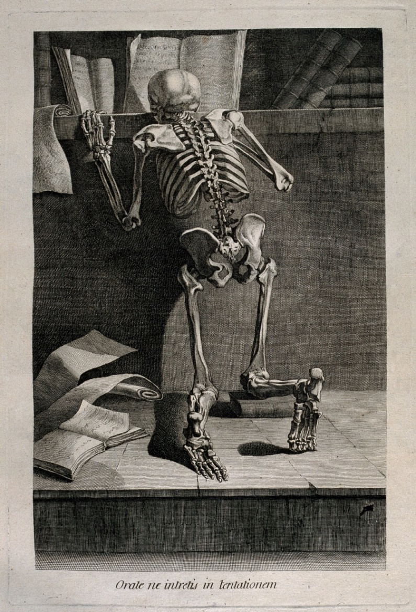
How to grade evidence?
Nouveau recueil d’ostéologie et de myologie. Toulouse, 1779. Jacques Gamelin, artist (1739-1803)

Slide 10
How to grade evidence?
Requires an objective and consistent method of assessing methodological quality.
Application of a grading system.
Consider sources of bias in each study.
Not to exclude studies, but to interpret synthesised evidence in context
Usually involves two, independent reviewers.

Slide 11
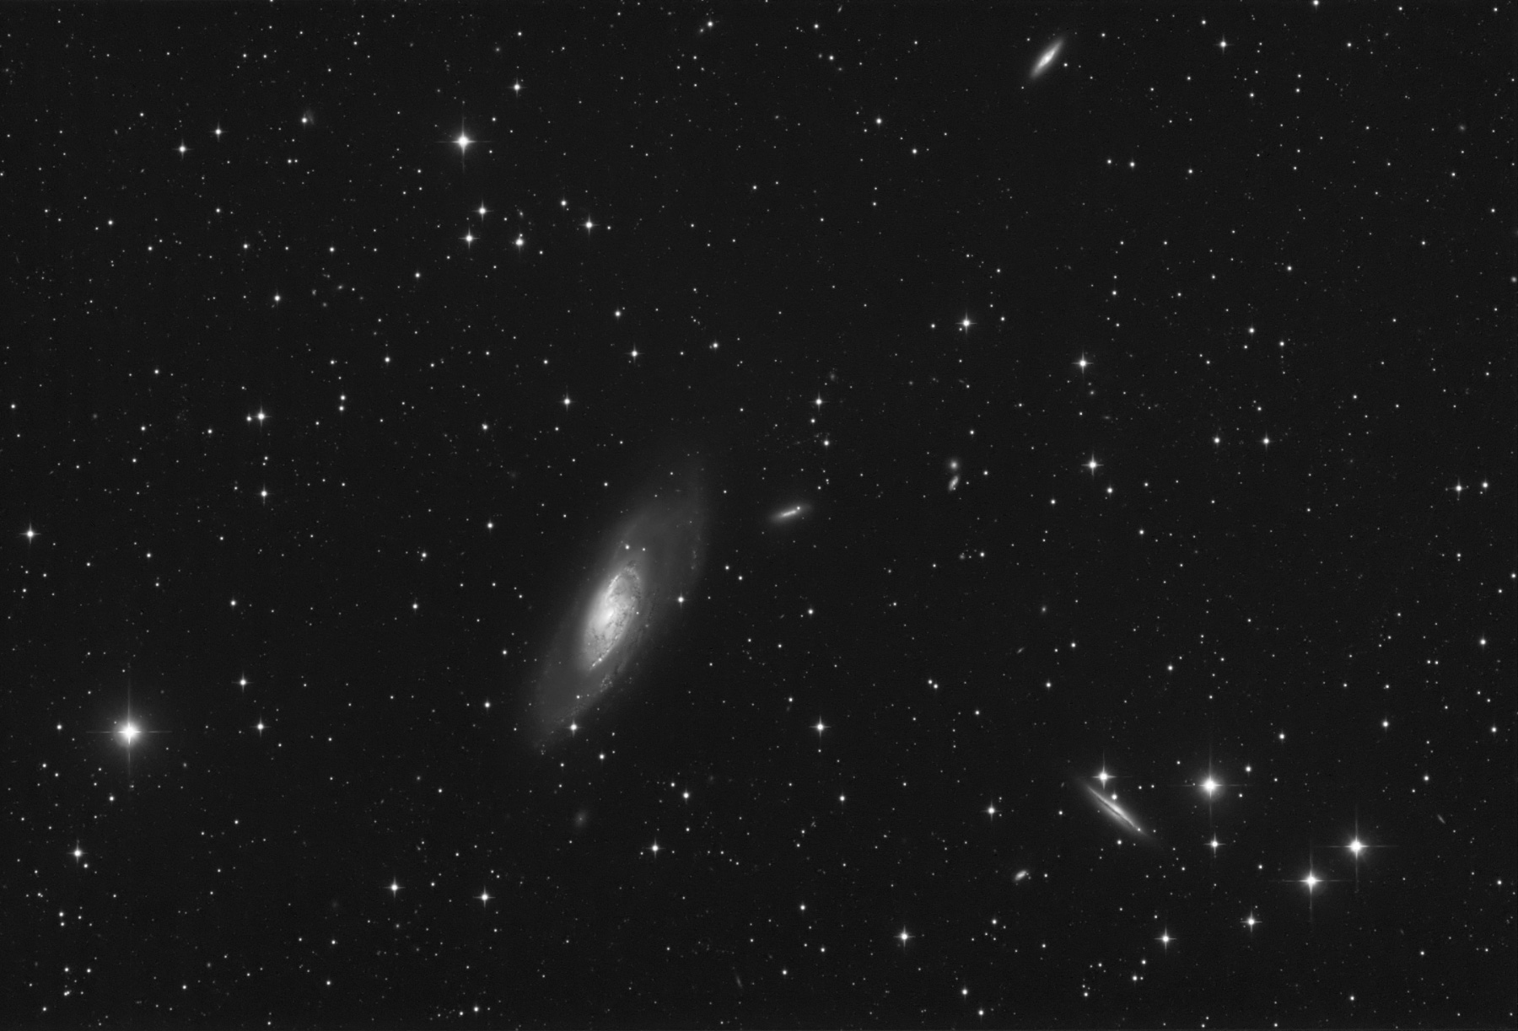
There is no “42”
‘Alright’, said Deep Thought. ‘The Answer to the Great Question …’
‘Yes …!’
‘Of Life, the Universe and Everything …,’ said Deep Thought.
‘Yes …!’
‘Is …,” said Deep Thought, and paused
‘Yes …!’
‘Is …’
‘Yes … !!! …?
‘Forty-two,’ said Deep Thought, with infinite majesty and calm
Adams D. Hitch Hiker’s Guide to the Galaxy. London: Pan Books, 1979

Slide 12
Available grading systems
Systematic review.
Randomised controlled trial.
Cohort study.
Case-control study.
Qualitative research.
Economic evaluation.
Diagnostic test.
Clinical prediction rule.

Slide 13
Cochrane risk of bias tool (RCT)
BIAS DOMAIN | SOURCE OF BIAS
Selection | Random sequence generation
 | Allocation concealment
Performance | Blinding to of participants/personnel
Detection | Blinding of outcome assessment
Attrition | Completeness of outcome data
Reporting | Selective outcome reporting
Other | Other concerns about bias
Overall grading: Unclear risk, Low risk or High risk

Slide 14
Newcastle-Ottawa scale (case-control)
QUALITY DOMAIN | SOURCE OF BIAS
Selection | Definition of cases
 | Representativeness of cases
 | Selection of controls
 | Definition of controls
Comparability | Comparability of cases and controls on the basis of design or analysis
Exposure (of interest) | Ascertainment of exposure
 | Same method for cases/controls
 | Non-response rate
Overall grading: Score 0-9

Slide 15
AMSTAR checklist (systematic review)
QUALITY DOMAIN / SOURCE OF BIAS
1. Was an ‘a priori’ design provided?
2. Was there duplicate study selection and data extraction?
3. Was a comprehensive literature search performed?
4. Was the status of publication used as an inclusion criterion?
5. Was a list of studies (included and excluded) provided?
6. Were the characteristics of included studies provided?
7. Was the scientific quality of included studies assessed and documented
8. Was scientific quality used appropriately in formulating conclusions?
9. Were the methods used to combine findings appropriate?
10. Was the likelihood of publication bias assessed?
11. Was the conflict of interest included?
Overall grading: Score 0-44

Slide 16
QUADAS (diagnostic accuracy studies)
QUALITY DOMAIN | SOURCE OF BIAS
Patient selection | Consecutive or random sample
 | Avoidance of case control design
 | Avoidance of inappropriate exclusions
Index test(s) | Index test results interpreted blind
 | Pre-specified threshold used (if applicable)
Reference standard | Reference standard likely to classify target condition
 | References standard results interpreted blind
Flow and timing | Appropriate interval between index and reference
 | All patients received reference standard
 | All patients received same reference standard
 | All patients included in analysis
Overall grading: Unclear risk, Low risk or High risk

Slide 17
Key points
Grading is necessary to differentiate between studies in terms of the reliability of evidence.
Is not necessary for non-systematic reviews.
When grading is required, it should be done objectively and consistently.
Usually involving two independent reviewers.
Various grading tools are currently available.
No single tool fits all evidence types.

Slide 18
Further information/tools
Centre for Reviews and Dissemination (CRD)
www.york.ac.uk/inst/crd/pdf/Systematic_Reviews.pdf
NICE: The Guidelines Manual
http://publications.nice.org.uk/PMG6B
The Cochrane Collaboration
http://handbook.cochrane.org/
Critical Appraisal Skills Programme (CASP)
www.casp-uk.net
Newcastle-Ottawa scale
www.ohri.ca/programs/clinical_epidemiology/oxford.asp
Quality Assessment Tool for Diagnostic Accuracy Studies
http://www.bris.ac.uk/quadas/
Assessing the Methodological Quality of Systematic Reviews
http://amstar.ca/

Slide 19
