Slide 1
EndNote X7 Advanced tips and tools
Rocio Rodriguez Information Specialist
Leeds, 25th January 2017 Academic Unit of Health Economics (AUHE)
.

Slide 2
Today’s session
Removing duplicate references
Editing multiple references
Changing Fields Display
Search Endnote Database
Finding Full Text
Creating Groups
Importing PDF Folders

Slide 3
1. Removing duplicates
Default Option (Matching on Author, Year, Title) Main Menu: References > Find Duplicates To get rid of all the duplicates we need to de-duplicate several times comparing different fields.
Advanced Option
Main Menu: Edit>Preferences>Duplicates Select the fields that you want to match

Slide 4
2. Editing multiple references
1) Selecting references
Hold SHIFT and down to highlight a batch of many references.
Hold Ctrl & left click to pick out a selection of references.
Showing references
Right click on the references and select ‘show selected references’.
Main Menu: Tools>Change/Move/Copy Fields If you select Replace whole field with this will completely delete anything that was already in the research notes field. Insert before field’s text or Insert after field’s text EndNote or select Clear field if you wish to delete existing research notes. Type in your research note and click OK.
Notes:
Important to “show selected refs” or it will change all the references

Slide 5
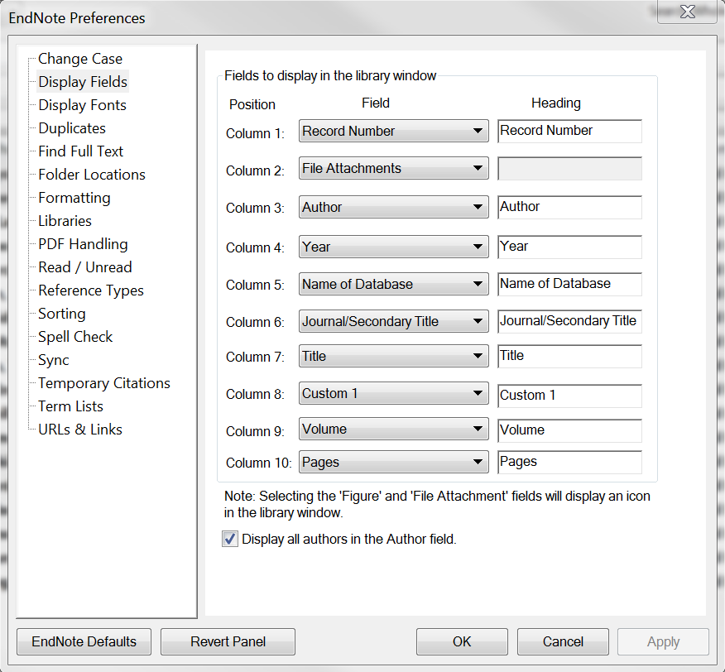
3. Changing Display Fields
You can decide which fields to display at the top of the screen.
Go to Main Menu Edit>Preferences>Display Fields.

Slide 6
4. Searching in EndNote

Slide 7
5. Finding Full Text
Automatic PDF finder
To switch off/on the automatic full text finder go to:
Edit>Preferences…>Find Full Text>
tick/untick “Automatically invoke Find Full Text on
newly-imported references”.
Find available PDFs.
Select References
Go to: References>Find Full Text.
Records with PDF attachments show paper clip symbols.

Slide 8
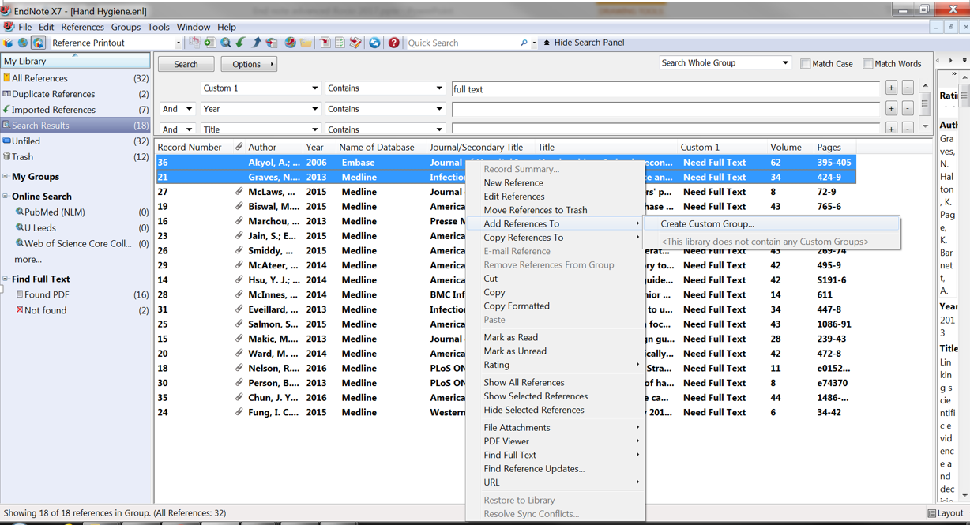
6. Creating Groups
Select References> Right Click>Add References to>Create Custom Group

Slide 9
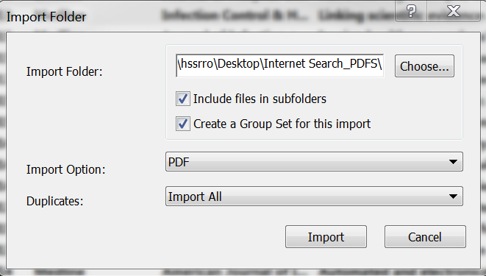
7. Importing Folders with PDFs
Main Menu: File> Import >Folder
If your pdfs are already grouped into subfolders choose
“Create Group Set” so they can be identified
Notes:
Demo importing a folder of pdfs
Discuss how it works via DOI and cross ref so older articles may not import properly – fix by adding details and find reference update
Importing into Mendeley possibly better for older articles

Slide 10
Further Help
1) Leeds University library: http://library.leeds.ac.uk/skills-endnote
LU referencing output style, workbooks for self training ,help and advice
2) You Tube: https://www.youtube.com/watch?v=lnqPjjKwEPkot
3) AUHE Mini master classes archive http://medhealth.leeds.ac.uk/info/698/lihs_mini-masterclasses/1440/mini-masterclass_archive Endnote resources http://medhealth.leeds.ac.uk/info/639/information_specialists/2044/endnote_resources Information Specialist advice clinics 30 min 1:1 sessions

