Slide 1
EndNote X7 Basics – getting started with EndNote X7
LIHS Mini Master Class
© Alexandru Nicusor Matei 2013 CC BY-NC-ND 2.0
Natalie King
Information Specialist, LIHS
Judy Wright © University of Leeds 2017. This work is made available for reuse under the terms of the Creative Commons Attribution-NonCommercial-ShareAlike 4.0 International Licence.

Slide 2
What is EndNote / Reference Management?
Create a personal electronic ‘library’ of references
From records you download e.g. MEDLINE, Google Scholar, CINAHL
Type in your own records
Remove duplicates
Organise references into ‘groups’, folders
Can cite automatically in Microsoft Word, reduces typing errors
Others ….. Reference Manager Mendeley, Zotero
Notes:
Demos of creating a library, a manual reference, importing references and exporting to a txt file, using cite while u write
Other mini-masterclass notes on Mendeley, see the mini-masterclass blog

Slide 3
Word and EndNote Example

Slide 4
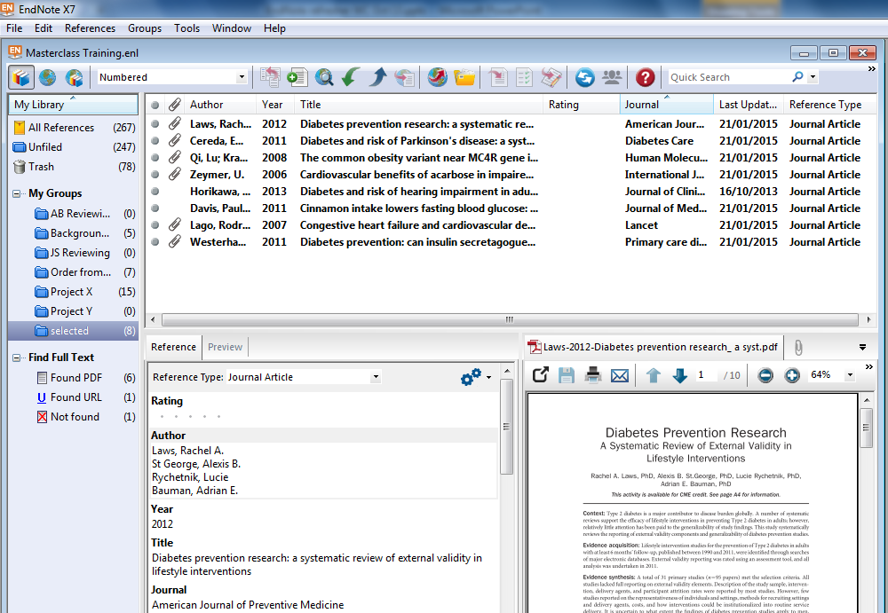
EndNote – key features
Notes:
Familiarise yourself with features: Reference display, preview, PDFs, Groups, Sorting

Slide 5
Starting up EndNote X7 - 1
Close the SYNC window
Close the Connect with Endnote window
(these does not appear in X6)

Slide 6
Starting up EndNote X7 – 2 Turn off Automatic full text finder
Saves time especially if using a ‘slow’ PC
Edit > Preferences > Find Full text
Deselect Automatically invoke Find Full text on newly-imported references

Slide 7
Demo Building the library
Manually add a reference
Import a file of references
Notes:
Demo:
Create a library
File>New>
Other points:
Find full text
Groups window
Reference window
Library window

Slide 8
Import records from 1 database at time
Searching and importing from multiple databases together e.g. Ovid Medline and Ovid Embase doesn’t work well
MeSH / EMTREE
Index Term Searching
EndNote Imports all records accurately

Slide 9
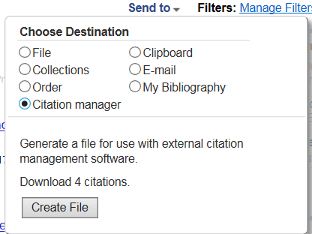
Getting records from Pubmed into EndNote
Notes:
Have saved search in MEDLINE – MED Chocolate Endnote Demo
*Select complete reference – best quality references wanted.
Direct export will not work if Endnote library is being used in a certain way(having a citation open seems to stop it working)

Slide 10
Getting records from Cochrane - save and import a file
Notes:
Importance of changing Import Option:

Slide 11
Find a filter to import your file correctly

Slide 12
Google Scholar Import

Slide 13
Google Scholar Import
Click import and the reference goes into your open EndNote library (or last used EndNote library)

Slide 14
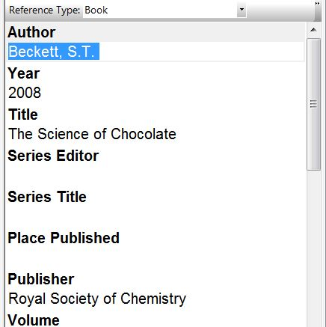
Manually adding a record
E.g. The Science of chocolate
Avoid if you can!
Needs to be perfect and complete
Select the appropriate Reference Type
Notes:
Change Reference Type – e.g. book
Can actually import this from google books – go to About this book

Slide 15
Change the display – show all citation details
Select
Edit
Preferences
Display Fields
Notes:
The amount of preferences has changed with new features added by X6 such as Read/unread feature etc.

Slide 16
Cite while you Write
Change referencing style e.g. Leeds-Harvard, Vancouver
Insert citation options
Create / update a bibliography

Slide 17
Create a list of references
Display and sort references of interest
Select File > Export
Choose an Output style e.g. ‘Annotated’ includes the abstract,
‘Numbered’ doesn’t.
3. Save as a .txt file
4. Open Word, then open your .txt file within Word
Notes:
If you would like our filter for this ask us!

Slide 18
Other useful features
Removing duplicates
Automatically finding full text papers
Updating a reference
Sorting references into group folders
Add your own coding / notes in Custom Fields
Annotating PDFs
Access via Desktop Anywhere
Sharing library with others (version 7.2 and higher)

Slide 19
Key points
Search and Import 1 database at a time
Quality of references “rubbish in – rubbish out”
If direct ‘export’ to EndNote doesn’t work properly, delete records and export using the ‘save and import’ process
Spend time finding a filter that works rather than editing lots of references
www.endnote.com - up-to-date filters for download

Slide 20
Further help
Library Support Pages https://library.leeds.ac.uk/researcher-endnote
IS Endnote resources for systematic reviews
http://medhealth.leeds.ac.uk/info/639/information_specialists/2044/endnote_resources
Upgrade to EndNote X8 - contact IT Service Desk

